Slide 1
Digital Image Processing 图像信息处理
宋明黎
brooksong@zju.edu.cn
计算机学院
浙江大学
2023秋冬学期
Mingli Song
College of Computer Science, Zhejiang University
brooksong@zju.edu.cn
http://person.zju.edu.cn/msong/

Slide 2
Main content
Representation of grayscale image and color image
Image format and R/W
Basic principle of imaging
Physical meaning of color and color vision
Color space: definition and transformation
Data structure of image processing
Programming for image processing
Understanding image in computer
Access DIB: brief introduction of typical APIs
Visual C++ programming interface and code example
Image processing functions in Matlab
Popular image processing software

Slide 3
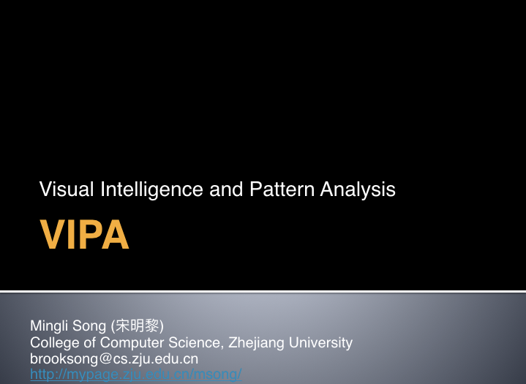
Then,

Slide 4
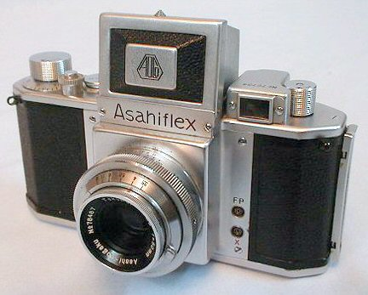
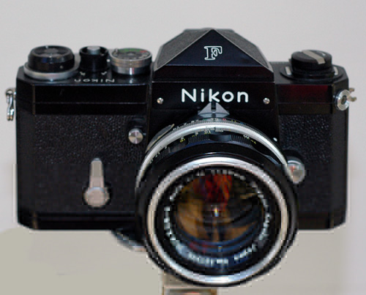
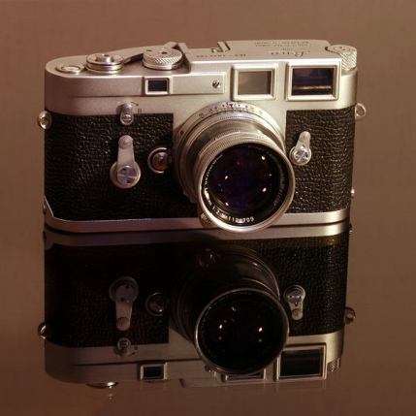
History of imaging devices
SLR: single len reflex
First design: 1933
First true 33mm SLR: Soviet “Sport”
Popular: after World War II.
Company: Pentax, Canon, Nikon, Leica
Notes:
是用一只镜头并通过此镜头反光取景的相机。
单镜头反光相机原理
所 谓“单镜头”是指摄影曝光光路和取景光路共用一个镜头，不像旁轴相机或者双反相机那样取景光路有独立镜头。“反光”是指相机内一块平面反光镜将两个光路分 开：取景时反光镜落下，将镜头的光线反射到五棱镜，再到取景窗；拍摄时反光镜快速抬起，光线可以照射到感光元件CMOS上。

Slide 5
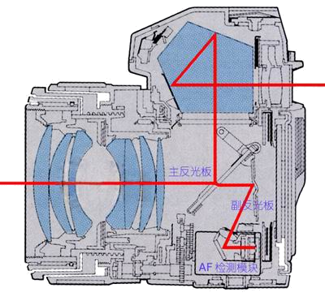

Slide 6
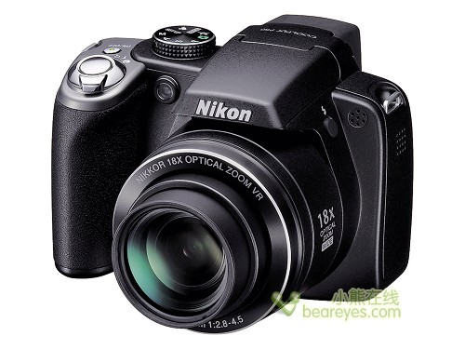
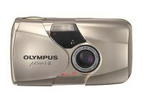
History of imaging device
Automatic camera
1970s, first automatic exposure camera.
1982: first ”compact camera”
Notes:
1982: first ”compact camera”-傻瓜相机

Slide 7

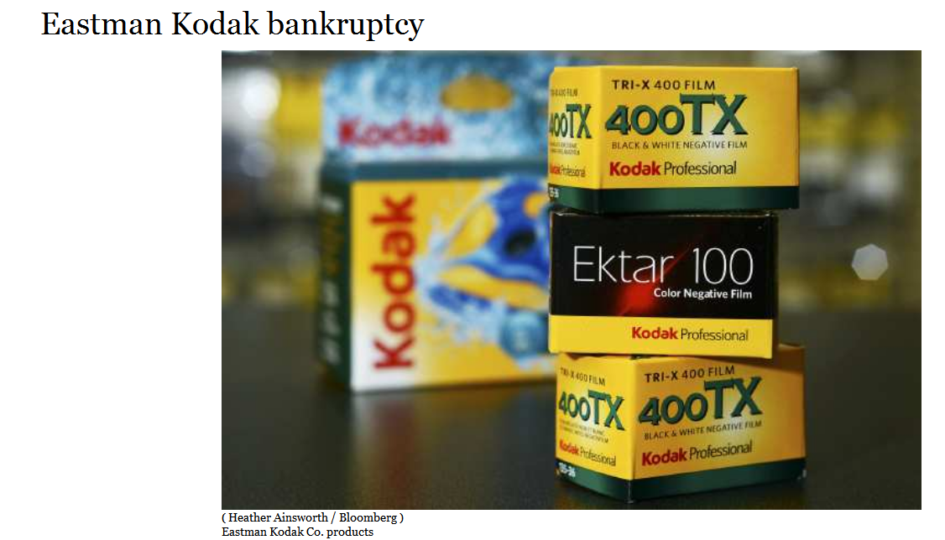
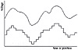
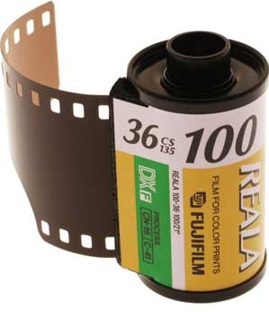
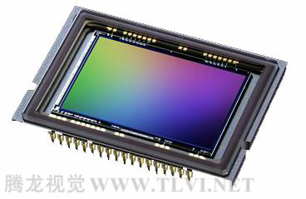
History of imaging device
Digital age
film
Charge-coupled Device，CCD

Slide 8
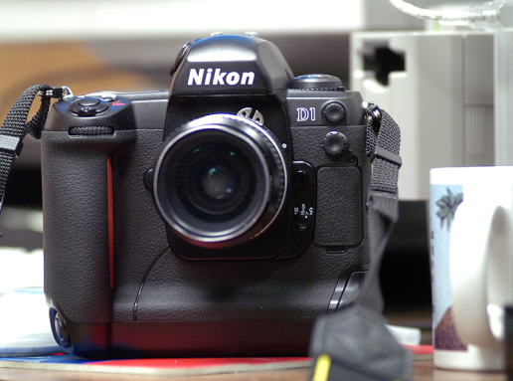
History of imaging device
Digital camera
Begin in 1961 towards altitude measuring of spacecraft.
The first true digital camera: 1988, Fuji DS-1P, never exported.
The first commercially available digital camera: 1990-Logitech Fotoman.
Representative product: Kodak DCS-100.
The first DLSR: Nikon D1

Slide 9
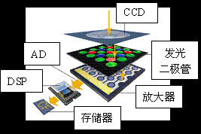
photo-diode
光电
amplifier
memory

Slide 10
The principle imaging process of DC
（1）When taking photograph, the light from the scene goes through the lens and reaches CCD.
（2）When CCD being exposed, the photodiode is stimulated to release charges, and produces electrical signals.
（3）CCD controlling chip controls the electric flow through the controlling signal circuit in photoperceptive component. CCD will collect such electrical signals and output them to an amplifier.
（4）After amplifying and filtering, the electrical signals reach ADC. And ADC transfer such electrical signals (continuous) to digital ones (discrete). The value of digital signal is proportional to the intensity of electrical signal and voltage. These values are corresponding to those of an image.
（5）But the above data cannot be treated as image directly. They will be further processed by DSP (digital signal processing). In DSP, color correction and white balance will be performed to obtain a qualified image, and the image will be encoded into the supported format and resolution, which can be stored as a image file.
（6）After the above steps, the image file appears on your memory card and can be previewed.
Notes:
(1)当使用数码相机拍
(2)当CCD曝光后，光电二极管受到光线的激发而释放出电荷，生成感光元件的电信号。摄景物时，景物反射的光线通过数码相机的镜头透射到CCD上。
(3) CCD控制芯片利用感光元件中的控制信号线路对发光二极管产生的电流进行控制，由电流传输电路输出，CCD会将一次成像产生的电信号收集起来，统一输出到放大器。
(4)经过放大和滤波后的电信号被传送到ADC，由ADC将电信号（模拟信号）转换为数字信号，数值的大小和电信号的强度与电压的高低成正比，这些数值其实也就是图像的数据。
(5)此时这些图像数据还不能直接生成图像，还要输出到DSP（数字信号处理器）中，在DSP中，将会对这些图像数据进行色彩校正、白平衡处理，并编码为数码相机所支持的图像格式、分辨率，然后才会被存储为图像文件。
(6)当完成上述步骤后，图像文件就会被保存到存储器上,我们就可以欣赏了。

Slide 11
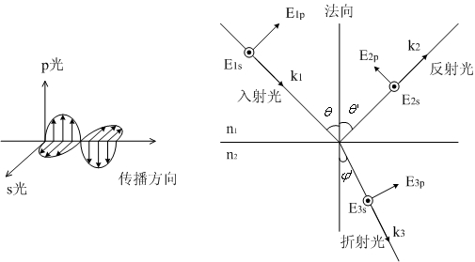
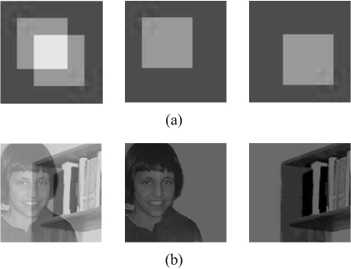
Physical meaning of color
Colorful view is generated by the interactions between light and objects, e.g., reflection, refraction, scattering, transmission, absorption, and diffraction.
-> a low level but open problem: Dichromatic Reflection Separation
Reflection and refraction on material surface
Notes:
色彩场景是由光与物体之间的交互过程产生的。如：反射、折射、散射、传播、吸收以及衍射等等。

Slide 12
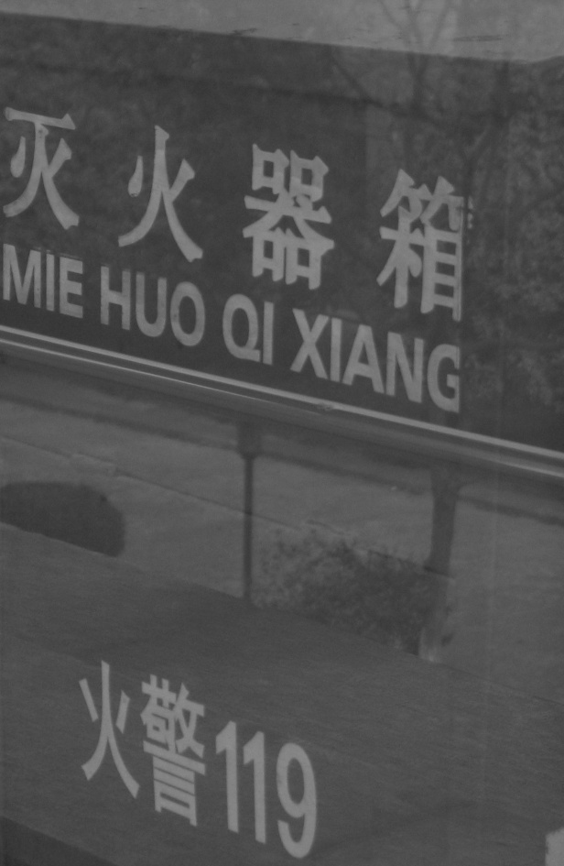

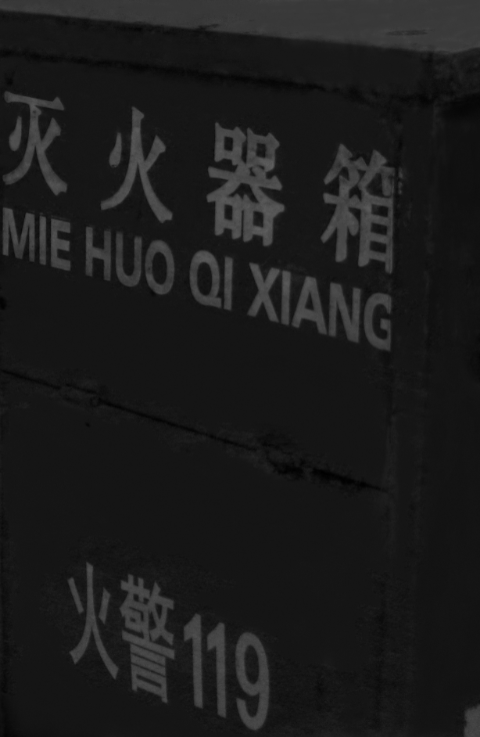
Some separation results of our method

Slide 13
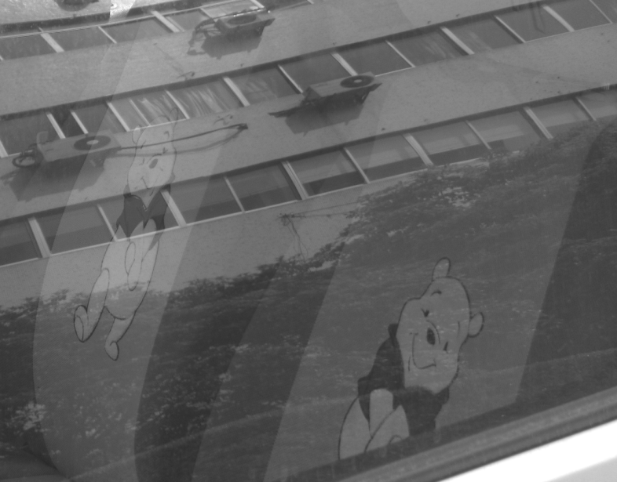
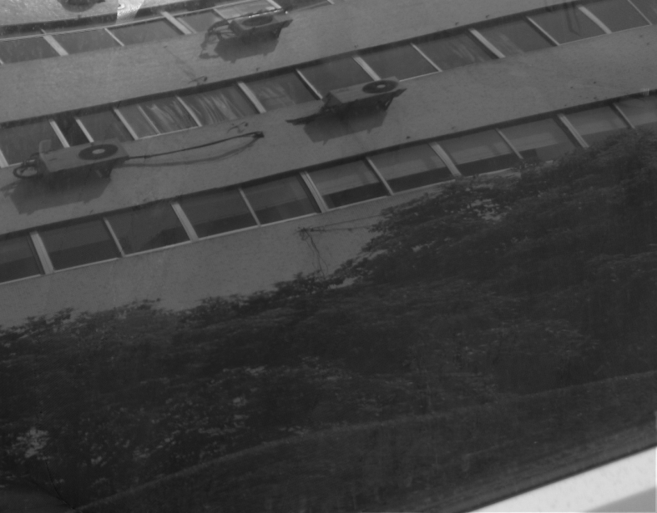
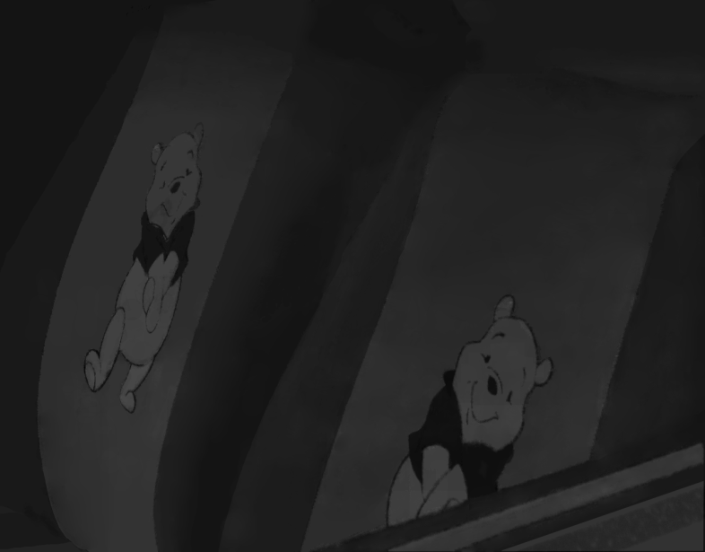

Slide 14
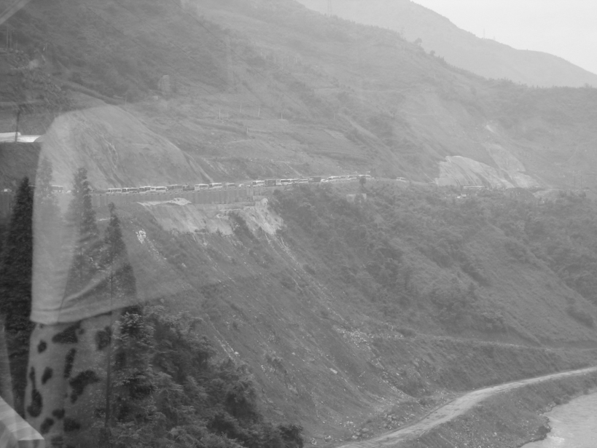



Slide 15
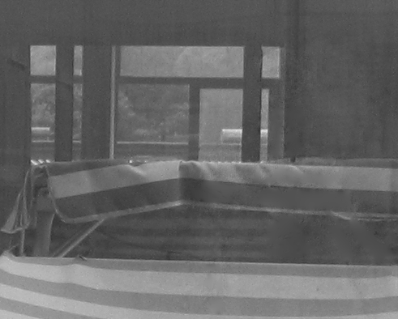
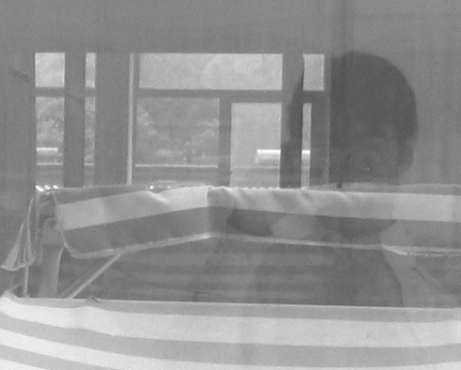
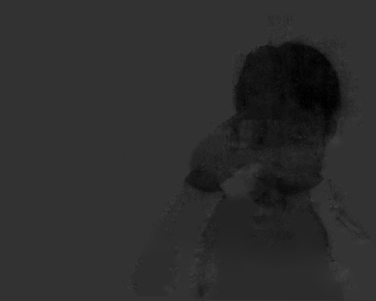

Slide 16
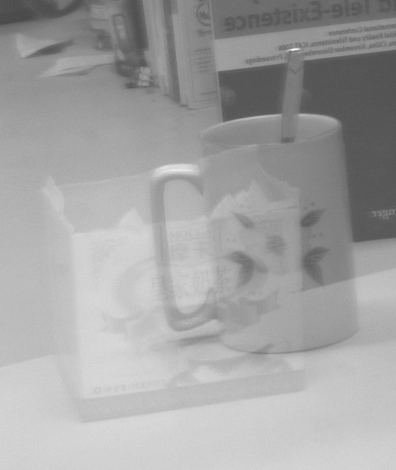
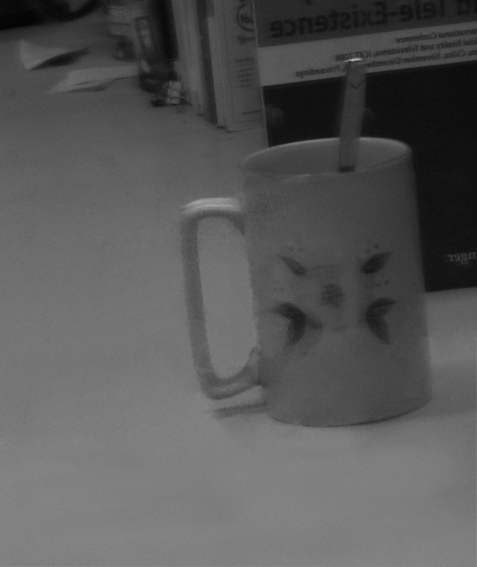
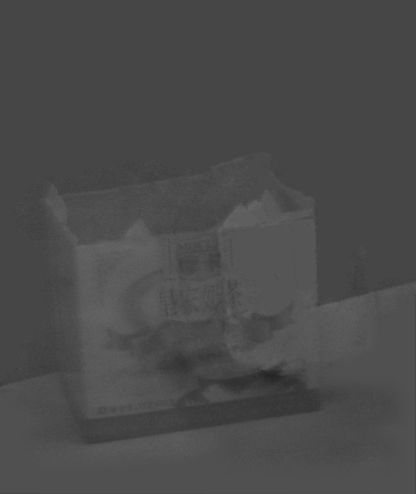

Slide 17
Color can be divided into chromatic color and achromatic color.
Chromatic color means the monochrome color (red, yellow, blue, etc.) and their combination. The colorful objects reflect the light selectively to the light spectrum of different wavelengths. Hence, they present different color under white light.
Achromatic color, also called non- chromatic color OR grayscale, means white, black and the gray intensities between them. The achromatic objects do not select the wavelength, so they are in neutral color.
Notes:
色彩可以分为彩色（chromatic color）和消色（achromatic color）两大类。
彩色是指红、黄、蓝等单色以及它们的混合色。彩色物体对光谱各波长的反射具有选择性，所以它们在白光照射下呈现出不同的颜色。
消色，又称非彩色，也就是我们通常所说的灰度，是指白色，黑色以及各种深浅不同的灰色。消色物体对光谱各波长的反射没有选择性，它们是中性色。

Slide 18
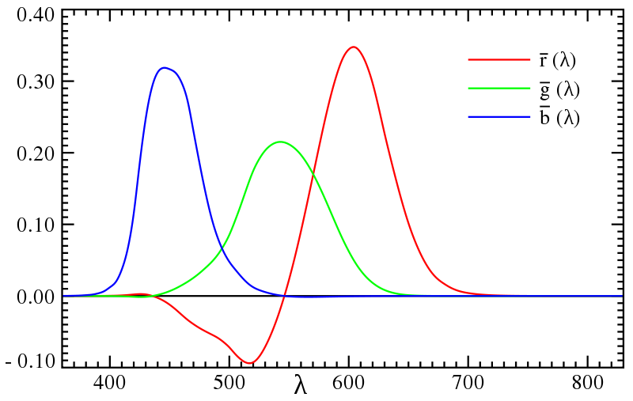
Light and color
Color vision is the feeling of human brain when lights of different wavelengths reach retina. The visible wavelength lies between 390nm~780nm. Normally, human can identifies 120~180 colors including the 7 principle colors purple, blue, cyan, green, yellow, orange and red.
Notes:
色觉是指不同波长的光线作用于视网膜而在大脑中引起的感觉。人眼可见光线的波长是390nm～780nm，一般可辨出包括紫、蓝、青、绿、黄、橙、红7种主要颜色在内的120～180种不同的颜色。
视网膜是人眼中最重要的组成部分，就像相机里的感光底片，专门负责感光成像。
视网膜上分布着两种视觉细胞，一种为杆状体，另一种为锥状体。杆状体细胞比较多，大约有上亿个，它对光极为灵敏，但没有区分色彩的能力。锥状体细胞则只有六、七百万个，它要在较强的照度下才能激发，它的存在使我们能够辨别各种不同的颜色。

Slide 19
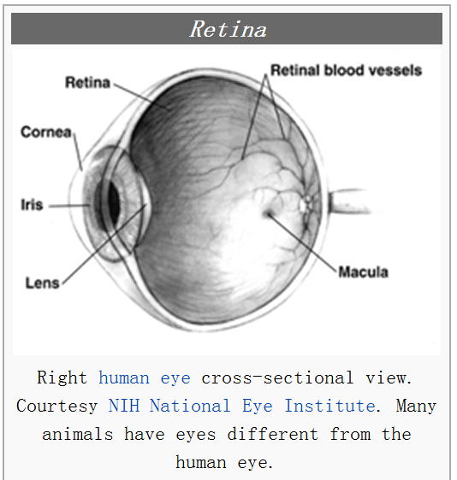
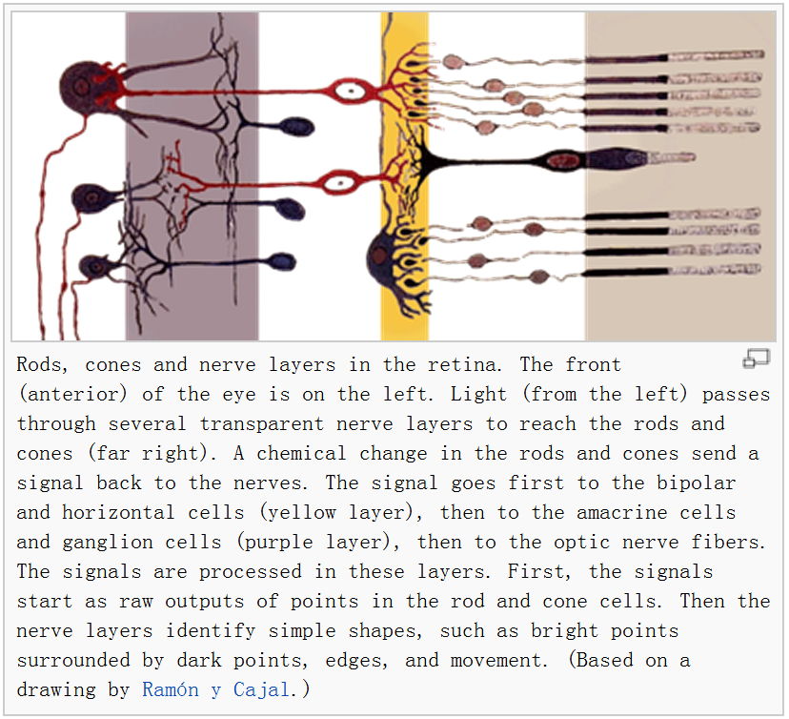
Retina is the most important part of human eyes, like the film in an camera, to capture the light and produce image. There are two kinds of vision cell on the retina: rods and cones.
Rods: ~100, 000, 000, sensitive to light but cannot identify different colors.
Cones: ~6,000,000-7,000,000, work under strong light, but can identify different colors.

Slide 20
Three-primary colors
Three-primary colors is a typical explanation of color vision mechanism
It is believed that there are three kinds of cones or photopigments corresponding to RED, GREEN and BLUE’s wavelengths.
When light of specific wavelength reaches human eyes, the corresponding cones are stimulated and cause the color vision (color perception) in human brain.
If three kinds of cones are stimulated equivalently, achromatism will happen.
Notes:
三原色是目前最为代表性的色觉机制解释：
在视网膜上存在着三种分别对红、绿和蓝光线的波长特别敏感的视锥细胞或相应的感光色素，当不同波长的光线进入人眼时，与之相符或相近的视锥细胞发生不同程度的兴奋，于是在大脑产生相应的色觉；三种视锥细胞若受到同等程度的刺激，则产生消色。

Slide 21
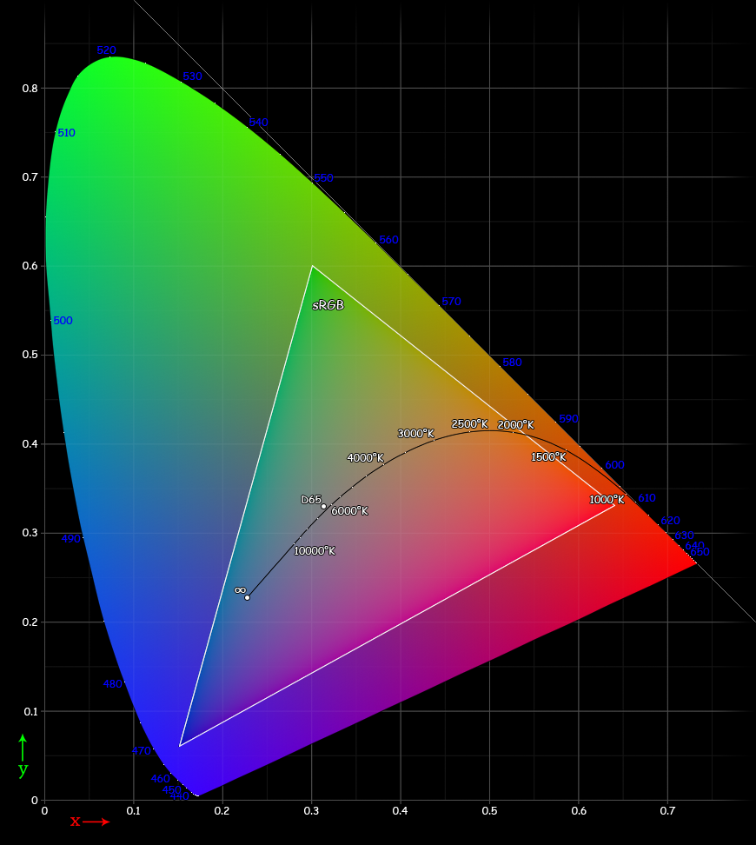
Color vision basic
Commission internationale de l‘éclairage (CIE)，based on the existing experimental results, select 700nm (R), 541.6nm (G), and 435.8nm (B) as the three-primary colors, and the corresponding spectrum distribution of stimulation is computed and demonstrated as below （Left).
1931 CIE RGB system: Standard color vision observer’s three-primary color spectrum distribution of stimulation
Color space
Notes:
国际照明委员会（Commission internationale de l‘éclairage），简称CIE，在1931年根据已有的实验结果，选择700nm（R）、541.6nm（G）、435.8nm（B）作为三原色，计算出相应的光谱三刺激值 r、g 、b ，其三刺激值曲线如图所示：

Slide 22
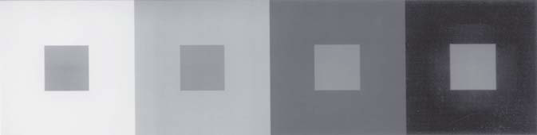
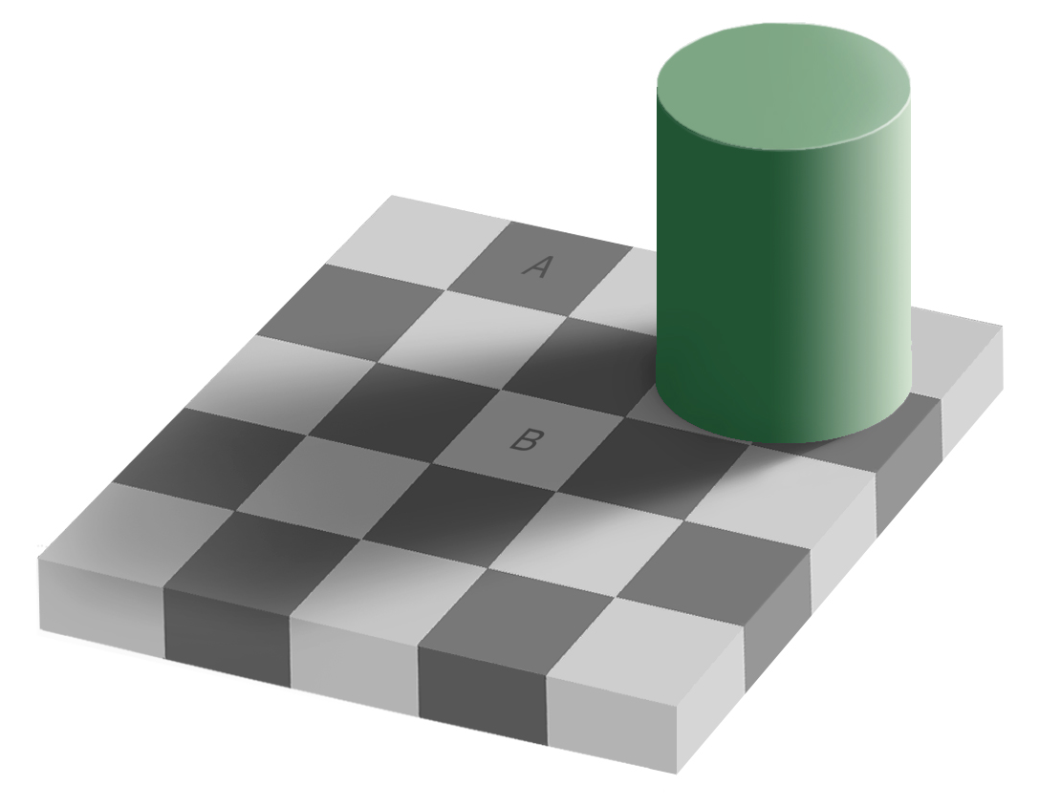
Properties of color vision
Absolute color vision is not precise: Human identifies color by visual context.
Notes:
绝对色觉感知不准确，一般通过上下文判断。所以说有时候会出错，这个叫vision illusion

Slide 23


Properties of color vision
Perceptive ability
Apart from the above, different people may have different perceptive abilities.

Slide 24
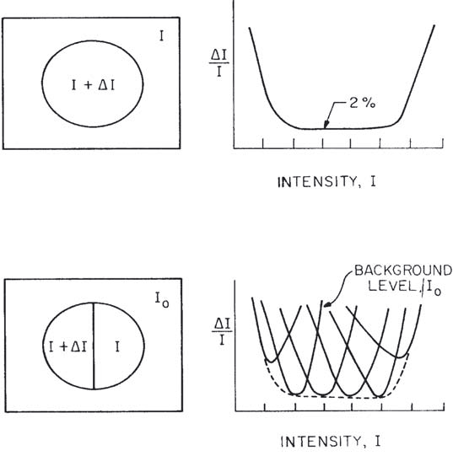
Properties of color vision
Weber’s Law
The sensible difference (visible contrast) is proportional to the intensity of background.
William K. Pratt, Digital Image Processing (Fourth Edition), Wiley-Interscience, 2007.

Slide 25
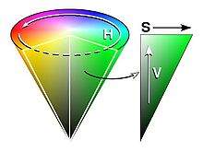
Perception priority and sensitivity
Priority: Under the same setting, human notices first the hue (H) changes, then the saturation (S), then the lightness value (V).
Sensitivity: Human eyes are the most sensitive to the lightness changes and have the best resolution, which is responsible for the eyes’ HDR capacity.
D. Malacara, Colour Vision and Colourimetry Theory and Applications, SPIE Press, 2002.
Notes:
感知的优先程度和敏感度
优先程度：同等条件下，人们往往会注意到色调（Hue, H）的变化，然后是饱和度（Saturation, S），然后是亮度（Value, V）。
敏感度：人眼对于亮度的变化最为敏感，分辨能力最强。恰好与人眼的高动态能力相匹配。

Slide 26
Definition of color space
Device dependent color space model:
RGB
CMY
HSV
Device independent color space model
Most of them are defined by CIE (Commission Internationale de L‘Eclairage/International Commission on Illumination):
CIE XYZ, CIE L*a*b, CIE YUV
Notes:
与设备有关的颜色模型:
RGB, CMY, HSV
与设备无关的颜色模型：
主要是国际照明委员会(CIE, Commission Internationale de L‘Eclairage/International Commission on Illumination)定义的CIE
CIE XYZ, CIE L*a*b和 CIE YUV

Slide 27
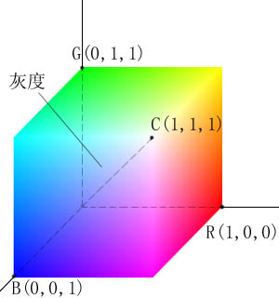
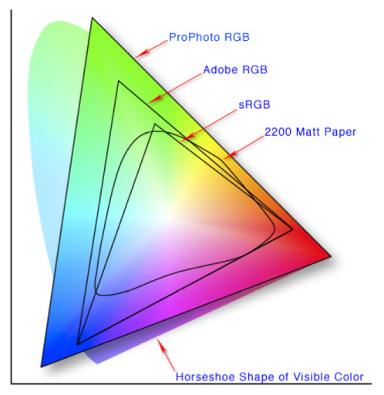
RGB color model
蓝(0,0,1)
青(0,1,1)
RGB color model is a unit cube in a Cartesian coordinates system.
The magnitudes of each primary color are equivalent on the main diagonal line, which lead to the white color from darkness to brightness, i.e., grayscale.
(0,0,0)-dark, (1,1,1)-bright. The other 6 corners are respectively red, yellow, cyan, blue and magenta.
RGB is a subset of CIE primary color space.
RGB is usually used in Color cathode ray tube and Color raster graphics display (computer , TV).
Magenta(1,0,1)
Brightness(1,1,1)
Darkness(0,0,0)
Green(0,1,0)
Red(1,0,0)
黄(1,1,0)
Notes:
RBG 颜色模型是三维直角坐标颜色系统中的一个单位正方体
在正方体的主对角线上，各原色的量相等，产生由暗到亮的白色，即灰度。（0，0，0）为黑，（1，1，1）为白，正方体的其他6个角点分别为红、黄、绿、青、蓝和品红。
RGB颜色模型构成的颜色空间是CIE原色空间的一个真子集。
RGB颜色模型通常用于彩色阴极射线管和彩色光栅图形显示器（计算机和电视机采用）。

Slide 28
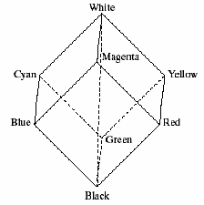
CMY color model
Color printing paper don’t emit light:
REFLECTION, ABSORTION
So printer uses ink or powder to colorize the paper, where the ink can absorb some colors but reflect the other colors.
Ink or pigment:
Complementary color of RBG: Cyan, Magenta, Yellow
The color from CMY model is called subtractive color because it subtracts (absorbs) the some reflected light. 。
Notes:
彩色印刷或者彩色打印的纸张不能发射光线，因而印刷机或打印机就只能使用一些能够吸收特定光波而反射其他光波的油墨或者颜色。
油墨或颜料的3种基色是以红、绿、蓝三色的补色青（Cyan）、品红（Magenta）、黄（Yellow）为基色。
用CMY模型产生的颜色称为相减色，是因为它减掉了为视觉系统识别颜色所需要的反射光

Slide 29
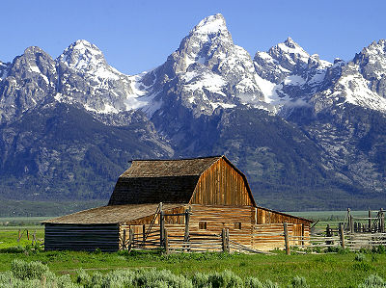
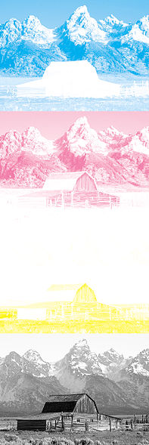

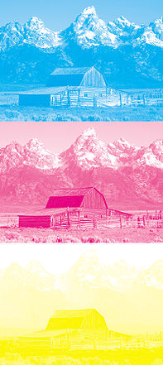

CMY color model

Slide 30
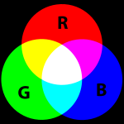
Subtractive color
Additve color

Slide 31
Difference between RGB and CMY
 | RGB | CMY
Primary color | R, G, B | C, M, Y
Rule | R+G=Y R+B=M G+B=C R+G+B=W | Y+M=R C+Y=G C+M=B C+M+Y=K
Mechanism | Color + light, energy increases. | Light-Pigment mixture, energy decreases.
Effect | Lightness increases | Lightness decreases
Complementary relation | Additive color | Subtractive color
Application | Color movies, TV, etc. | Painting, Photography, printing, etc.
Notes:
CMY空间与RGB空间互补，也就是用白色减去RGB空间中的某一颜色值就等于同样颜色在CMY空间中的值

Slide 32
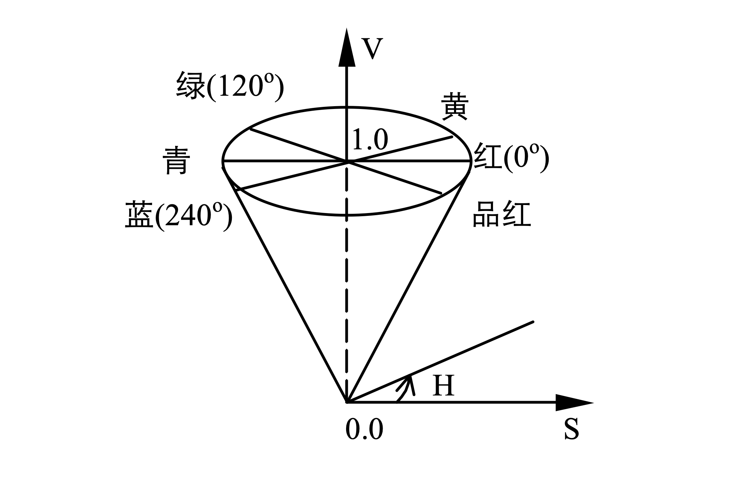
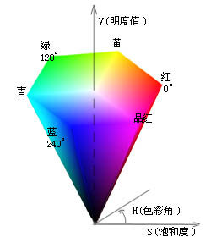
HSV color model
HIS/HSV color space is defined based on human visual system.
Hue, Saturation, Intensity/Value
HIS can be depicted as a cone
Top surface of cone: V=1, which includes R=1, G=1, B=1.
Hue: around the axis: RED-> 0º , GREEN-> 120º , BLUE-> 240º
Saturation: along the radial direction.
Bottom point of cone: V=0，H =null, S=null, for darkness.
Center of the top surface: S=0, V=1, H=null, for brightness.
Notes:
颜色空间是从人的视觉系统出发，用色调（Hue)、色饱和度（Saturation）和亮度（Intensity，或者Value）来
圆锥的顶面对应于V=1，它包含RGB模型中的R=1，G=1，B=1三个面，故所代表的颜色较亮。色度H由绕V轴的旋转角给定。红色对应于角度0º，绿色对应于角度120º，蓝色对应于角度240º。描述颜色。
在圆锥的顶点处，V=0，H和S无定义，代表黑色。

Slide 33
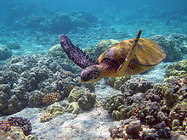
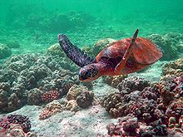
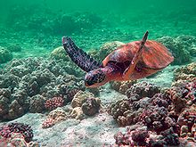
Advantage of HSV color model
Close to human color vision.
When using RGB or CMY, if you want to change hue, you must adjust R, G, and B at the same time. But using HSV, you DON’T have to do that. Only ONE channel is adjusted.
HSV color model is a uniform color space, linearly distributed. The color difference perception is proportional to Euclidean distance on the HSV cone volume.
Hue: rotate while preserving lightness unchanged.
Hue: rotate30 degree.
Original image
Notes:
符
当采用RGB（或者CMY）颜色模型时，改变某一颜色的属性，比如改变色调就必须同时改变R、G、B（或者C、M、Y）三个坐标；而采用HSV颜色模型时只需改变H坐标。也就是说，HSV颜色模型中的三个坐标是独立的。合人眼对颜色的感觉。
HSV颜色模型构成的是一个均匀的颜色空间，采用线性的标尺，彩色之间感觉上的距离与HSV颜色模型坐标上点的欧几里德距离成正比。

Slide 34
CIE color model
CIE color model
A series of color models according to the response of human eyes to RGB, which are carefully measured.
Device independent
Such color models are used to define device-independent color.
Help people to reproduce color consistently on different devices such as scanner, monitor, and printer.
CIE color models
CIE XYZ,
CIE L*a*b
CIE YUV
etc.
Notes:
颜色模型包括一系列颜色模型，这些颜色模型是由国际照明委员会提出的，是基于人的眼睛对RGB的反应，被用于精确表示对色彩的接收。
设备无关性
这些颜色模型被用来定义所谓的独立于设备的颜色。它能够在任何类型的设备上产生真实的颜色，例如：扫描仪、监视器和打印机。这些模型被广泛地使用，因为它们很容易被用于计算机，描述颜色的范围。
CIE颜色模型的类型
CIE的模型包括：CIE XYZ, CIE L*a*b和 CIE YUV等。
这些颜色模型被用来定义所谓的独立于设备的颜色。它能够在任何类型的设备上产生真实的颜色，例如：扫描仪、监视器和打印机。这些模型被广泛地使用，因为它们很容易被用于计算机，描述颜色的范围。

Slide 35
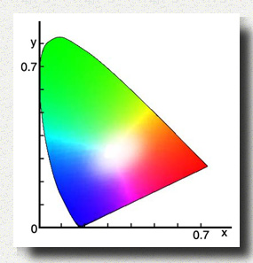
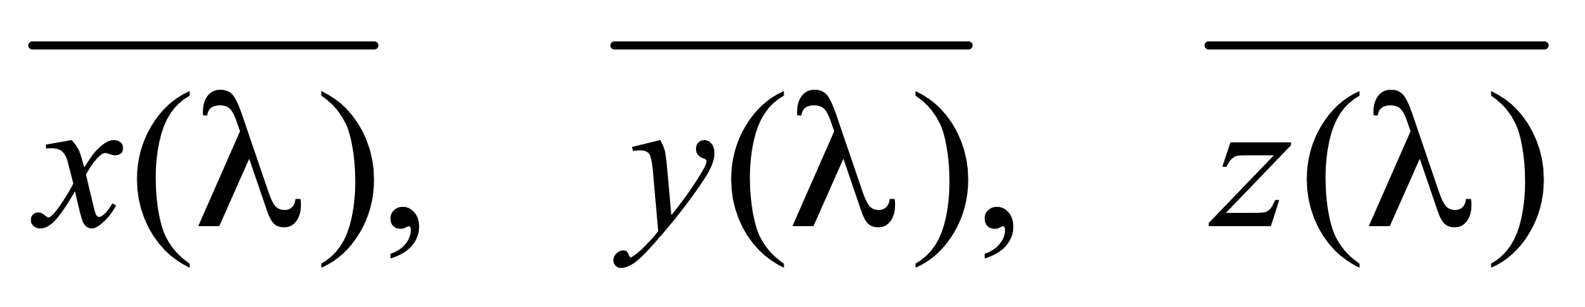
CIE XYZ
XYZ concept is based on the three-primary color theory, which describes human eyes have RGB receptors and all other color are mixture of RBG.
Defined in 1931.
Computed by using functions
Yxy color space given in 1931: Y->luminance, x,y are color coordinates computed based XYZ.
Describes the color range human can perceives.
CIE彩色图表
Notes:
XYZ 三刺激值的概念是以色视觉的三元理论为根据的，它说明人眼具有接受三原色(红、绿、蓝)的接受器，而所有的颜色均被视作该三原色的混合色。
1931年CIE制定了一种假想的标准观察者，设置配色函数
XYZ三刺激值是利用这些标准观察者配色函数计算得来的。
在此基础上，CIE于1931年规定了Yxy颜色空间，其中Y为亮度，x,y是从三刺激值XYZ计算得来的色坐标。它代表人类可见的颜色范围。

Slide 36
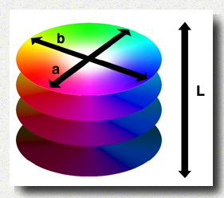
CIE L*a*b*
Defined in 1976
Modification of CIE XYZ
Overcomes the un-proportional problem in Yxy color space: x,y distance does not reflect the color difference you observe.
L: lightness
a: green to red
b: blue to yellow
L, a, b can be adjust separately.
L*a*b* concept
L: lightness
a: green to red
b: blue to yellow
Notes:
L*a*b*颜色空间是在1976年制定的，它是CIE XYZ颜色模型的改进型，以便克服原来的Yxy颜色空间存在的在x，y色度图上相等的距离并不相当于我们所觉察到的相等色差的问题。
它的“L”（明亮度），“a”（绿色到红色）和“b”(蓝色到黄色)代表许多的值。与XYZ比较，CIE L*a*b*颜色更适合于人眼的感觉。
利用CIE L*a*b*，颜色的亮度（L）、灰阶和饱和度（a,b）可以单独修正，这样，图像的整个颜色都可以在不改变图像或其亮度的情况下，发生改变。

Slide 37


CIE YUV
Used in TV.
Like Lab at some level.
Lightness is computed as:
Color differences U, V are computed as:
Notes:
在现代彩色电视系统中，通常采用三管彩色摄像机或彩色CCD（电荷耦合器件）摄像机，它把摄得的彩色图像信号，经分色，分别放大校正得到RGB，再经过矩阵变换电路得到亮度信号Y和两个色差信号R－Y、B－Y，最后发送端将亮度和色差三个信号分别进行编码，用同一信道发送出去。这就是我们常用的YUV颜色空间。
采用YUV颜色空间的重要性是它的亮度信号Y和色度信号U、V是分离的。如果只有Y信号分量而没有U、V分量，那么这样表示的图就是黑白灰度图。彩色电视采用YUV空间正是为了用亮度信号Y解决彩色电视机与黑白电视机的兼容问题，使黑白电视机也能接收彩色信号。
根据美国国家电视制式委员会，NTSC制式的标准，当白光的亮度用Y来表示时，它和红、绿、蓝三色光的关系可用如下式的方程描述：

Slide 38
Transformation between color spaces
RGB<->CMY
RGB<->HSV
RGB<->CIE XYZ
CIE XYZ<->CIE L*a*b*
RGB<->CIE YUV

Slide 39
RGB<->CMY
RGB->CMY
C = 255 – R
M = 255 – G
Y = 255 – B

Slide 40
RGB<->HSV
Search in table
CIE has defined transformation tables
RGB<->XYZ
HSV<->XYZ
Hence, you can
RGB->XYZ, XYZ->HSV
HSV->XYZ, XYZ->RGB

Slide 41

RGB<->HSV
Compute directly
From RGB to HSV
Assume m=max(r, g, b)，n=min(r, g, b), where r, g, b are normalized.

Slide 42




RGB<->HSV
From HSV to RGB

Slide 43

RGB<->CIE XYZ in a computable way

Slide 44

CIE XYZ<->CIE L*a*b*
L:(0,100)
a, b: (-300, 300) -a to +a: green to red
-b to +b: blue to yellow

Slide 45

RGB<->CIE YUV

Slide 46

JPEG format
Joint Photographic Experts Group, JPEG
Founded in 1986, presented JPEG in 1992, accepted by ISO in 1994.
File extension: .JPEG, .JFIF, .JPG, .JPE
Compression format for static image
As a counterpart of Moving Picture Expert Group.
Lossy encoding method
Allow user to make balance between image quality and image size.
Encoding based on transformation, e.g. Discrete Cosine Transformation (DCT)
JPEG2000 is based on wavelet.
Different manipulations for high-frequency signal and low-frequency signal.
High freq
Low freq.
Notes:
最后一条：
对图像高频区域和低频区域区别对待。想想计算机体系结构中的哈弗曼编码，低频部分放在树的顶端，高频部分放在树的低端

Slide 47

Compression strategy: According to the requirement of compression ratio, remove information from high frequency to low frequency.
Advantages
High frequency information occupies much more memory. Hence, high frequency removal leads to high compression ratio;
Low frequency information preserves the principle structure and color distribution of object, which is the key factors of an image.
Suitable for internet based visual media.
From Left to Right: Compression ratio increases.
Notes:
压缩策略：根据压缩比要求，从高频到低频逐步削减信息
好处
高频信息占用存储空间大，减少高频信息更容易获得高压缩比；
低频信息可以保留物体的基本轮廓和色彩分布，最大限度维持图像质量。
适合用于互联网

Slide 48
JPEG syntax
JPEG file is composed by a series of segments, where each segment begins with a Marker.
Purpose of Marker: identify the image data and relative information.
Marker specification: Each Marker is composed by 2 bytes, where the first byte is constantly oxFF.
SOI | 0xD8 | Beginning of image
APP0 | 0xE0 | JFIF application data block
APPn | 0xE1-0xEF | Other application data block
DQT | 0xDB | Quantization table
SOF0 | 0xC0 | Beginning of frame
DHT | 0xC4 | Huffman table
SOS | 0xDA | Beginning of scan
EOI | 0xD9 | End of image
Notes:
JPEG文件是由一系列的segment组成的，每个segment从一个标记（Marker）开始。
标记目的：用以区分和识别图像数据及其相关信息
标记规范：每个标记都是由2个字节组成，其前一个字节是固定值0xFF

Slide 49
JPEG file organization (1)
SOI(Start of Image) Marker
APP0 Marker
APP0 Marker:
Length
Identifier
Version
Density unit of X and Y:
units=0-> no unit
units=1: points/inch
units=2: points/cm
X density
Y density
Number of thumbnail horizontal pixels
Number of thumbnail vertical pixels
Thumbnail RGB bitmap

Slide 50


JPEG file organization (2)
(3) APPn (Markers)，n=1~15(optional)
APPn Length
Detail information: e.g., EXIF use APP1 to store meta data.
EXIF=Exchangeable image file format

Slide 51
JPEG file organization(3)
(4) One or more DQT（Define Quantization Table）
Three parts：
Quantization table length
Quantization table number
Quantization table
For a large region, human eyes can identify the subtle changes of color (low frequency region), but are very fair for the high frequency region.
Inspired by this concept, we can quantize the high frequency part to make quantization. In other words, each component on the spectrum can be divided by a constant and rounded to be zero. And different constants are required by different components. So finally we get the Quantization Table.
Notes:
人眼对于一个相对较大范围的区域，辨别色彩细微差异能力比较强（低频），但对于高频区域，却表现一般。受此启发，人们可以对高频部分进行量化，也就是说，把频域上的每个分量，除以针对该分量的常数，然后四舍五入取整，这样一般会把高频分量变为0。但这样操作就要求针对每一个分量设置一个常数值，所以就最终形成了量化表。

Slide 52
JPEG file organization (3)
(5) SOF0 (Start of Frame, DCT based)
Start of frame length
Precision: color depth (bit-width) of each color channel
Image height
Image width
Number of color components
For each color component
ID
vertical sample factor
horizontal sample factor
Quantization table #
Notes:
帧图像开始

Slide 53
JPEG file organization(4)
(6) DHT(Define Huffman Table)
Huffman table length
Type, AC or DC
Index
bits table
value table
DCT based compression
Notes:
一个或多个Huffmann表
霍夫曼表的长度(Huffman table length)
类型、AC或者DC(Type, AC or DC)
索引(Index)
位表(bits table)
值表(value table)

Slide 54
JPEG file organization (5)
(7) Start of Scan (SoS)
SoS length
Number of color components
For each color component
ID
AC table #
DC table #
Compress image data
(8) End of Image (EOI)
Notes:
(7) 扫描开始SOS(Start of Scan)
扫描开始长度(start of scan length)
颜色分量数(number of color components)
每个颜色分量
ID
交流系数表号 (AC table #)
直流系数表号 (DC table #)
压缩图像数据 (Compress image data)
(8) 图像结束EOI(End of Image)

Slide 55

JPEG file structure

Slide 56

JPEG encoding principle
DPCM encoding, (differential pulse-code modulation, DPCM) is a modulation technique invented by the British Alec Reeves in 1937. It is a digital representation of an analog signal where the magnitude of the signal is sampled regularly at uniform intervals.
Notes:
DPCM编码, differential pulse-code modulation，是对模拟信号幅度抽样的差值进行量化编码的调制方式。这种方式是用已经过去的抽样值来预测当前的抽样值，对它们的差值进行编码。差值编码可以提高编码频率，这种技术已应用于模拟信号的数字通信之中。

Slide 57

JPEG uses DCT
Note: JPEG is NOT JPEG2000
The DCT transforms an 8×8 block of input values to a linear combination of these 64 patterns. The patterns are referred to as the two-dimensional DCT basis functions, and the output values are referred to as transform coefficients.

Slide 58


Quality: Higher quality (Q = 100)
Size: 83,261 bytes
Compression rate: 2.6:1
Quality: Higher quality (Q = 50)
Size: 15,138 bytes
Compression rate: 15:1

Slide 59


Quality: Higher quality (Q = 25)
Size: 9,553 bytes
Compression rate: 23:1
Quality: Higher quality (Q = 10)
Size: 4,787 bytes
Compression rate: 46:1

Slide 60

Quality: Higher quality (Q = 5)
Size: 2,396 bytes
Compression rate: 100:1

Slide 61




JPEG’s disadvantages
Not for line drawing, text, symbol, icon, etc..
Its lossy compression leads to unavoidable artifacts.
Notes:
不适合用于线条画、文字、图标等，其有损压缩会导致这类对象的瑕疵严重

Slide 62


JPEG
JPEG

Slide 63
TIFF format
TIFF (Tagged Image File Format): an extensively used raster image format for:
scanner
CAD system
GIS (Geographic Information System)
…
Filename extension | .tiff, .tif
Type code | TIFF
Uniform Type Identifier | public.tiff
Developed by | Aldus, now Adobe Systems
Initial release | 1986
Type of format | Image file format
Extended to | Exif, DCF, TIFF/EP, TIFF/IT, TIFF-FX, GeoTIFF
Notes:
TIFF是Tagged Image File Format的缩写，是一个广为应用的光栅图像文件格式，它的来源有：
扫描仪
CAD系统
地理信息
…
1986年发表最早的版本V1、V2
1989年发表版本V5.0
1992年，V6.0
TIFF是一个非常稳定的文件格式，有很长的应用历史
有公共的软件库来读写TIFF格式的图像（支持各种操作系统）

Slide 64
TIFF characteristics
Universal: Support devices from high-end to low end
Highly extendable: support public tag and private tag
Flexible: Support several compression formats
Accessible: public software library available
Powerful
Binary image
Grayscale image
Palette
True color
Other extension.
Notes:
支持从高端到低端的设备
可扩展性强，支持公共和私用的标记结构
支持各种压缩格式
有公共软件库支持
二值图
灰度图
调色板
真彩色
其他扩展

Slide 65
TIFF file structure
struct TIFF_img {
unsigned char **mono;
unsigned char **cmap;
unsigned char ***color;
char TIFF_type;
char compress_type;
int height;
int width;
};

Slide 66


GIF examples

Slide 67
GIF file format
Graphics Interchange Format
LZW encoding method is employed.
One GIF stores several image frames.
Has color table (global (all frames) or local color table)
Support display order custom or lay over.
Allow interlacing store
Support text embedding
Notes:
采用复杂的LZW编码方式
一个GIF文件可以存储多幅图像
带有色彩表（全局、局部色彩表）
支持图像定序显示或覆盖
可以错行存放
支持文本覆盖

Slide 68

GIF file structure

Slide 69


Slide 70
Image processing data structure
Matrices
Chains
Topological Data Structures
Rational Structures
Note
Matrices to rational structures is a kind of relationship from low level to high level, i.e., from semantic independent to semantic dependent.
Notes:
(矩阵式)
(链式)
(拓扑数据结构)
(有理数据结构/合理数据结构)
Matrix 到有理数据结构是一个由底层到高层的关系，由没有语义到有语义。

Slide 71
Matrices
Matrix is the most common data structure for low-level representation of an image
Elements of the matrix: gray level, brightness, or other properties
Access via coordinates of pixel location
Binary images: represented by a matrix containing only zeros and ones

Slide 72


Matrices of different resolution
Multispectral image represented by several matrices: each matrix containing an image corresponding to one spectral band
Original face image

Slide 73
Chains
Chain codes: Chains are used for description of object borders
Chains can be represented using static data structures (e.g., 1D arrays); their size is the longest length of the chain expected.

Slide 74

Chains: Run length encoding (RLE)
In binary images, run length coding records only areas that belong to the object in the image; the area is then represented as a list of lists.
Each row of the image is described by a sublist, the first element of which is the row number.
Subsequent terms are coordinate pairs; the first element of a pair is the beginning of a run and the second is the end.
There can be several such sequences in the row.

Slide 75
Image processing programming
Windows APIs for accessing DIB
VC++ programming and example
Matlab image processing toolbox

Slide 76
Windows APIs for accessing DIB
LoadImage
HANDLE LoadImage(HINSTANCE hinst,
LPCTSTR lpszName,
UINT uType,
int cxDesired,
int cyDesired,
UINT fuLoad
);
Display DIB
BitBlt
SetDIBitsToDevice
StretchDIBits
#include <windows.h>

Slide 77

VC++ programming and example

Slide 78

VC++ programming and example

Slide 79
Matlab image processing toolbox
MATLAB and Image Processing Toolbox provide lots of image processing functions.
Users can use these functions to analyze the image data, acquire image details and design suitable filters.
With the designed filters, you can perform de-noise, enhancement, etc..
OR you can design a comprehensive filter by using Simulink: just drag-and-drop is needed.
Notes:
MATLAB 和 Image Processing Toolbox 提供了大量的用于图像处理的函数，用户可以利用这些函数分析图像数据，获取图像细节信息，并且设计相应的滤波算法。
利用设计的滤波算法可以将图像数据所包含的噪声滤除，而滤波器的设计师通过 MATLAB 产品提供的交互式工具完成的，这些工具还能够完成选区图像区域，测量图像误差和获取、统计像素信息等功能。

Slide 80
Matlab image processing functions
Imread
Imwrite
Imshow
I = imread('pout.tif');
imshow(I)
I2 = histeq(I);
Imshow(I2)

Slide 81
Image Processing Toolbox
Image display and exploration
GUI Tools
Spatial Transformation and Image Registration
Image Analysis and Statistics
Image Arithmetic
Image Enhancement and Restoration
Linear Filtering and Transforms
Morphological Operations
ROI-based, Neighborhood, and Block Processing
Colormaps and Color Space
Utilities: array operation, demos, preferences and others

Slide 82
Adobe Photoshop
Function:professional software for image processing
Image eidting
Filters
Tools: region selection, brush, …
Image layer
Color manipulation
Color depth adjustment
Luminance, contrast adjustment
Drawing and output
…
Notes:
功能：是专门用来进行图像处理的软件。
对图形进行修饰和编辑
滤镜(filters)
各种工具(区域选择工具、各种笔刷…)
多层(layer)
以及对图像的色彩处理;
颜色深度调节
亮度、对比度等条件
另外，还有绘图和输出功能等。

Slide 83
GIMP
Function：Professional open source image processing software under Linux and Windows
Image editing
Filters
Tools: region selection, brush
Image layer
Color manipulation
Color depth adjustment
Luminance, contrast adjustment
Drawing and output
Notes:
Linux下用来进行图像处理的软件。
对图形进行修饰和编辑
滤镜(filters)
各种工具(区域选择工具、各种笔刷…)
多层(layer)
以及对图像的色彩处理;
颜色深度调节
亮度、对比度等条件
另外，还有绘图和输出功能等。

Slide 84
Acdsee
ACDSee is a professional image browsing and lightweight image editing software
Support almost all kinds of image formats
Plugin supported
Video browsing supported

Slide 85


Shadow magic hands (光影魔术手)
A photo quality enhancement and personalization software.
Easy, simple and free to use

